Slide 1

Google Wave
Andres Ferrate
Developer Relations
Joe Gregorio
Developer Relations
Dan Peterson
Product Manager

Slide 2
Installation
Hello Robot!

Slide 3

Installing the tutorial code
http://...
OR
Grab a USB Key
Prerequisites: Python 2.5

Slide 4
Copy in tutorial examples
Code is under /tutorial1

Slide 5
Project Contents
app.yaml
index.yaml
robot.py
waveapi

Slide 6
robot.py
from waveapi import robot
from waveapi import events
from waveapi import appengine_robot_runner
def OnSelfAdded(event, wavelet):
wavelet.reply("Hello Everyone!")
if __name__=='__main__':
myrobot = robot.Robot("Greeter",
image_url='http://.../avatar.png',
profile_url='')
myrobot.register_handler(
events.WaveletSelfAdded, OnSelfAdded)
appengine_robot_runner.run(myrobot, debug=True)

Slide 7
Instantiate a robot
from waveapi import robot
from waveapi import events
from waveapi import appengine_robot_runner
def OnSelfAdded(event, wavelet):
wavelet.reply("Hello Everyone!")
if __name__=='__main__':
myrobot = robot.Robot("Greeter",
image_url='http://.../avatar.png',
profile_url='')
myrobot.register_handler(
events.WaveletSelfAdded, OnSelfAdded)
appengine_robot_runner.run(myrobot, debug=True)

Slide 8
Register for event(s)
from waveapi import robot
from waveapi import events
from waveapi import appengine_robot_runner
def OnSelfAdded(event, wavelet):
wavelet.reply("Hello Everyone!")
if __name__=='__main__':
myrobot = robot.Robot("Greeter",
image_url='http://.../avatar.png',
profile_url='')
myrobot.register_handler(
events.WaveletSelfAdded, OnSelfAdded)
appengine_robot_runner.run(myrobot, debug=True)

Slide 9
Respond to events
from waveapi import robot
from waveapi import events
from waveapi import appengine_robot_runner
def OnSelfAdded(event, wavelet):
wavelet.reply("Hello Everyone!")
if __name__=='__main__':
myrobot = robot.Robot("Greeter",
image_url='http://.../avatar.png',
profile_url='')
myrobot.register_handler(
events.WaveletSelfAdded, OnSelfAdded)
appengine_robot_runner.run(myrobot, debug=True)

Slide 10
app.yaml
application: <appid>
version: 1
runtime: python
api_version: 1
handlers:
- url: /_wave/.*
script: robot.py
Modify to match your app id.

Slide 11
Upload your robot
$ cd google_appengine/tutorial1/
~/Desktop/google_appengine/tutorial1
$ python ../appcfg.py update .
Application: jcgbot; version: 1.
Server: appengine.google.com.
Scanning files on local disk.
Initiating update.
Cloning 34 application files.
...

Slide 12
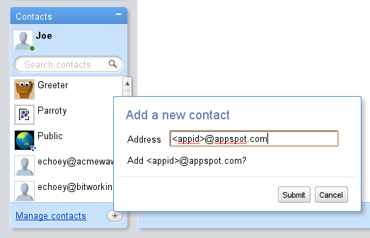
Test your robot

Slide 13
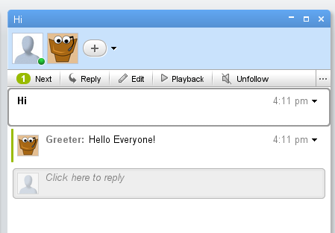
Test your robot

Slide 14
Debugging Tips
Follow the requests

Slide 15
Capabilities.xml
$ curl http://jcgbot.appspot.com/_wave/capabilities.xml
<?xml version="1.0"?>
<w:robot
xmlns:w="http://wave.google.com/extensions/robots/1.0">
<w:version>0x829a2cd</w:version>
<w:protocolversion>0.22</w:protocolversion>
<w:capabilities>
<w:capability name="OPERATION_ERROR"/>
<w:capability name="WAVELET_SELF_ADDED"/>
</w:capabilities>
</w:robot>

Slide 16
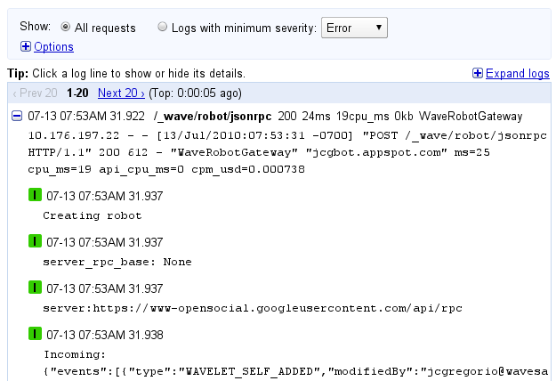
App Engine Logs
http://jsonlint.com/ is your friend

Slide 17
Thank You
Questions?

